Slide 1
Mobile Interface Design Best Practices
The following slides will help you design better mobile interactions experiences.

Slide 2
Focus on first time experience
Just like a person, your mobile app doesn’t get a second chance to make a good first impression. If you don’t, you can bet (with 80% confidence) they won’t be back.

Slide 3
Focus on first time experience
Perception of Complexity
The first thing users do when they see a new interface is estimate how much time is required to use it.
Perception plays a crucial role in the process of estimation. The more complex an interface looks, the more likely users will abandon the process.
Minimize Cognitive Load
The less friction and confusion users have when interacting with an app (e.g. the cognitive load), the better the chance that they continue using the app.

Slide 4
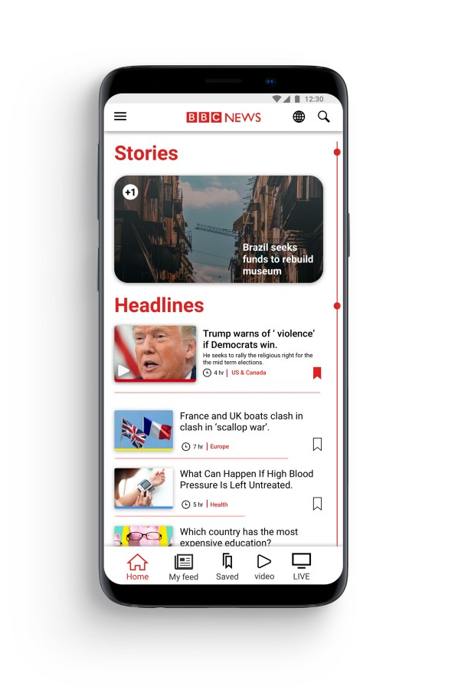
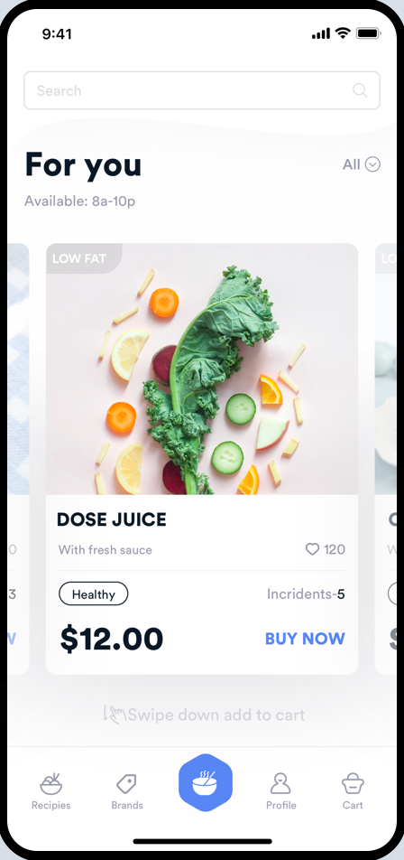
Focus on first time experience

Slide 5
Good on-boarding is a must
Designing a good on-boarding process is very important as it creates an orientation for first-time users. An on-boarding process convinces users of its importance by introducing users to the features of the app and what value it offers to the users.

Slide 6
Research before design
Although it is tempting to jump straight to design and start designing mockups, it’s important to do your research first. Proper research will help you understand who your users are and what they really need. The goal is to create an experience that truly resonates with your target audience.
Build user personas to under your users better and how they will interact with your app. Conduct a competitive analysis to find apps which are similar to yours and see what works and what doesn’t.

Slide 7
Optimise user flow
Understanding how users interact with an app is essential for optimisation. We should understand the user’s goals in the context of the entire user flow. This knowledge will help us identify the most common friction points during task completion.

Slide 8
Optimise user flow
Chunk Big Tasks
If a task contains a lot of steps and actions required from the user’s side, it’s better to divide such task into the number of subtasks.
Use existing user information
You probably already have a lot of information about your users — you just need to use it properly. Use existing information to automatically complete steps and make the user process simpler.
Provide a natural next step
When the task requires users to complete a number of steps, maintain momentum by clearly showing what’s next.
Prioritise one primary action
Make the interface both easier to learn and easier to use. Use visual weight to prioritise important elements (such as contrasting color for primary call-to-action button).

Slide 9
Prioritise features
To make an app more attractive to users, many product designers try to add as many features as possible. Unfortunately, this rarely results in better user experience. Nothing is more confusing for first-time users than an app that has too much going on. The most successful apps available on the market are highly focused and present a limited set of features.
Thus, limit your app’s feature set by prioritising what’s important and trimming nice-to-have features.
Focus on refining the experience around your core objectives.

Slide 10
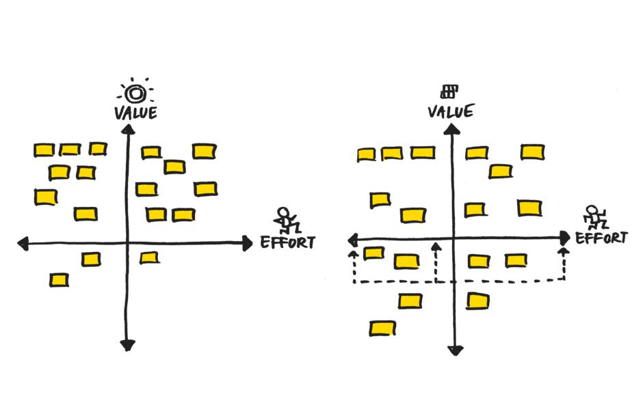
Prioritise features

Slide 11
Cut the clutter
Cluttering a user interface overloads your user with too much information — every added button, image, and line of text makes the screen more complicated. Clutter is terrible on a desktop, but it’s way worse on mobile devices where users have limited screen space.
It’s essential to get rid of anything in a mobile design that isn’t absolutely necessary because reducing clutter will improve comprehension.
Strive for minimalism
Focus on the content that is valuable for your users and remove unnecessary elements that do not support user tasks.
Prioritise one primary action per screen
Try to design each screen for one thing and one thing only, with no more than one call-to-action. This makes it both easier to learn and easier to use.

Slide 12
Make navigation easier
Having a great service or product won’t matter unless users can successfully navigate your app and access the features. Having easy navigation is important to ensure that users are able to navigate to different features on the app successfully use them.
Consistent navigation: Don’t hide menus on individual pages because it might confuse or disorient your users.
Communicate the current location: Failing to indicate the current location to users is the common problem for many mobile apps.
Use standard navigation patterns: Use native navigation patterns, which will be familiar to users. No need to get clever if a simple solution works.

Slide 13
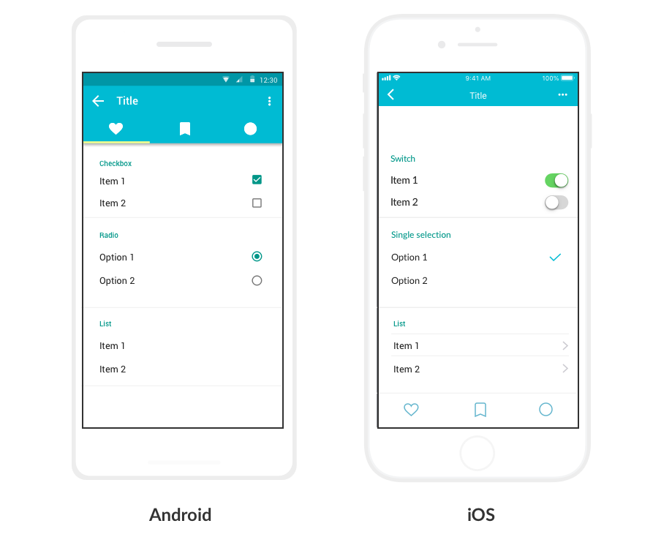
Make navigation easier

Slide 14
Use simple language
Every word in your app is part of a conversation with your users. Make this conversation comfortable for them by speaking the same language as your users. Use familiar, understandable words and phrases if you want your app to appeal to everyone.
Avoid acronyms, brand-specific terms, cultural-specific axioms, and technical terminology that people might not understand. In general, it’s better to use simple and direct language to maximise clarity.

Slide 15
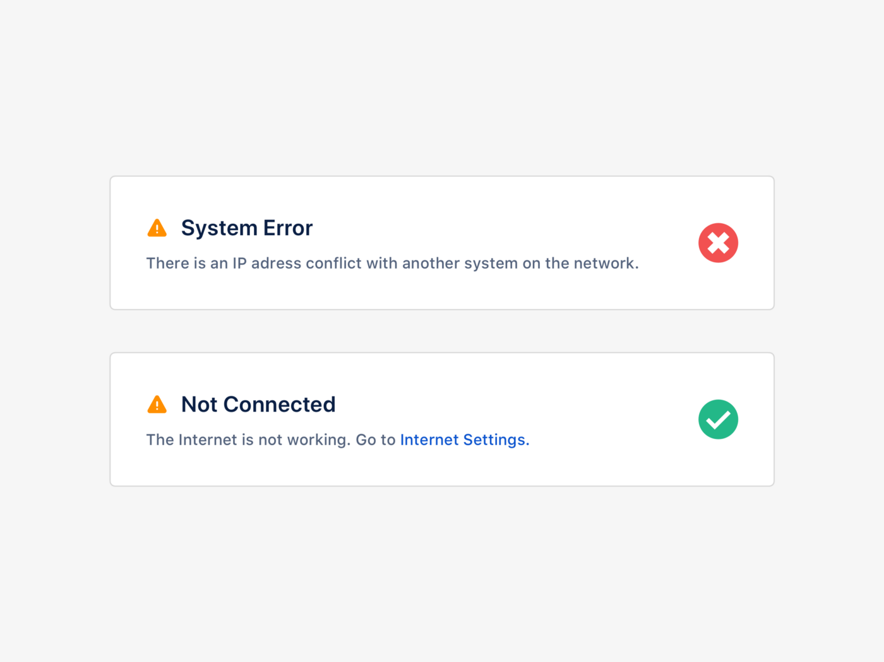
Use simple language

Slide 16
Design for interruption
We live in a world of interruption. Something is constantly trying to distract us and direct our attention elsewhere.
For example, users might use your app while waiting for the train. It’s critical to design for mobile mindset. Make it easier for users to re-engage with an app when they return to it after the interruption.

Slide 17

Design finger-friendly tap targets
Smaller touch targets are a common source of problems for mobile users — mistaken taps often happen because of small touch controls. When you’re designing mobile interfaces, it’s best to make your targets big enough so they’re easy for users to tap.

Slide 18
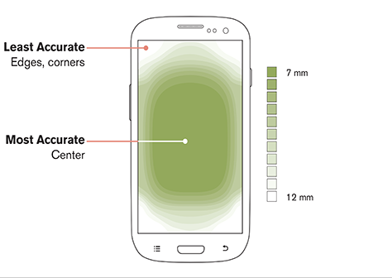
Keep elements within reach
Pay attention to how users use their phones. Most likely they’re using one of their thumbs to interact with the screen. According to UX experts, 75% of people only use one thumb to interact with their phone.
Hence we need to organise content in a way that puts primary interactions front and centre, saving secondary and tertiary functions for the top and bottom screen edges.

Slide 19
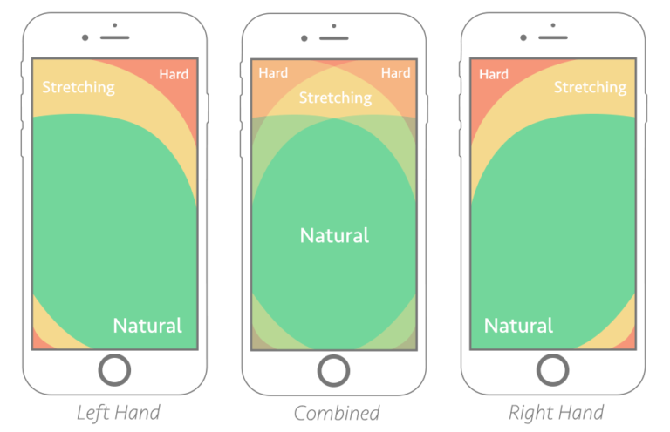
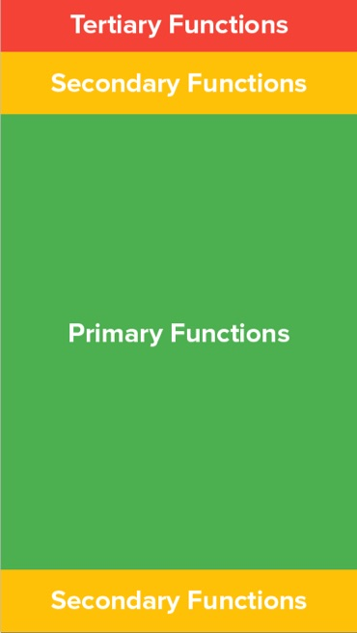
Keep elements within reach
The position of these functions relates directly to ease of access for a user. Primary functions lie in the area that users can access easily with their thumbs, while tertiary (and to some extent, secondary) functions lie in lower-accuracy zones and require a little more work to get to.

Slide 20
Make text legible
Content is the reason why people use your app and language — housed in typography (font) and shown as text on your screen, it is a big part of content. Making text legible is a mandatory requirement for each mobile interface.
Choose a typeface that works well in multiple sizes and weights to maintain readability and usability in every size. A safe bet is to rely on the platform’s default font.
Use a legible font size. Text should be at least 11 points so users can read it at a typical viewing distance without zooming.
Use sufficient color contrast for text. Insufficient contrast makes text blend in with the background.

Slide 21
Provide feedback on interactions
Each human-computer interaction is based on two fundamental elements — user input and computer reaction to it. To make the interaction predictable, it’s essential to provide some sort of feedback in response to every user action.
Feedback acknowledges actions and helps users understand the results of operations.
Feedback helps people know what an app is doing now.
For example: Based on the type of UI element or current state of the app, designers can use different forms of feedback. For example, interactive elements can be highlighted briefly when tapped, progress indicators can be used to communicate the status of long-running operations, and animated effects can help clarify the results of operations.

Slide 22
Provide feedback on interactions
Each human-computer interaction is based on two fundamental elements — user input and computer reaction to it. To make the interaction predictable, it’s essential to provide some sort of feedback in response to every user action.
Feedback acknowledges actions and helps users understand the results of operations.
Feedback helps people know what an app is doing now.
For example: Based on the type of UI element or current state of the app, designers can use different forms of feedback. For example, interactive elements can be highlighted briefly when tapped, progress indicators can be used to communicate the status of long-running operations, and animated effects can help clarify the results of operations.

Slide 23
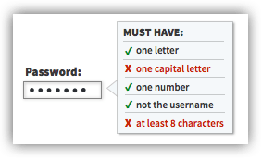
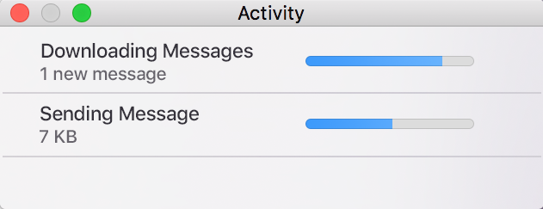
Provide feedback on interactions

Slide 24
Let’s get started…
Thank You

